Slide 1



Final Presentation – Project A Cooperative LDPC Decoder for a Ternary Memory Channel
Students: Saar Stern, Yoav Cohen
Supervisor: Yuval Ben Hur
Semester: winter 2023
Date: 27/12/2023

Slide 2

Project Goal
Develop a decoder for LDPC error correction code over a “barrier” ternary channel, that will outperform the “standard” decoder.
Notes:
- חיפשנו פרויקט מעניין, יובל הציג לנו, אהבנו (אין לנו רקע) , למדנו.
- מטרת הפרויקט פיתוח מפענח לקוד תיקון שגיאות המבוסס LDPC מעל ערוץ "בריאר" טרנארי.

Slide 3
Outline
LDPC recap
Barrier Channel
LDPC-Barrier
Results
Summary and future work

Slide 4
LDPC Low density Parity check

Slide 5
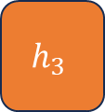
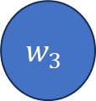
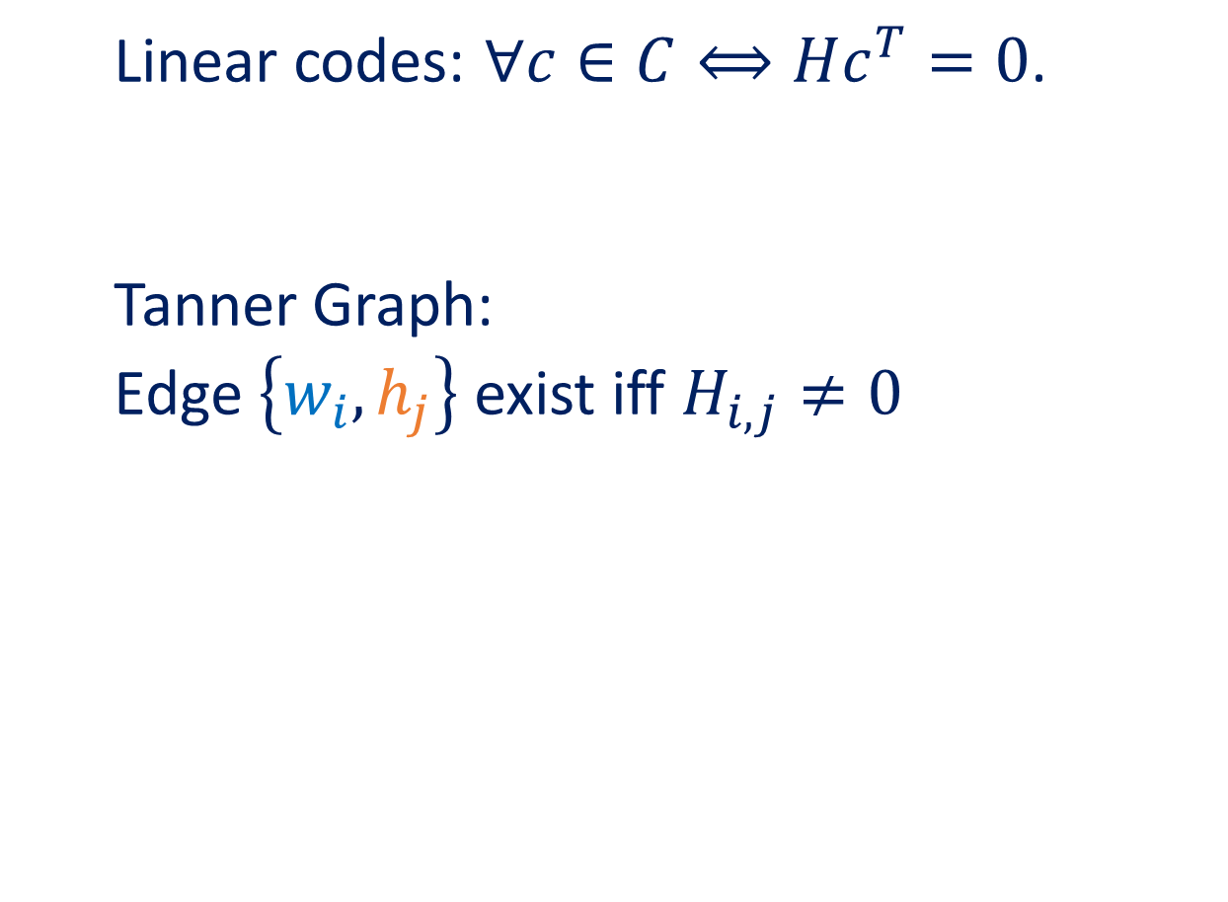

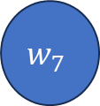

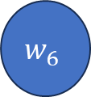
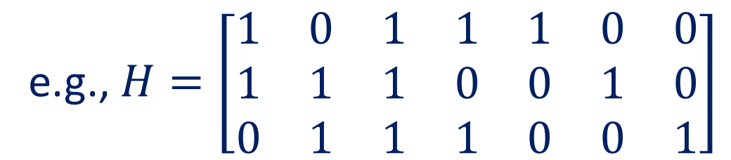



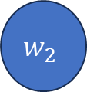
Linear codes and LDPC
Linear codes: $∀c∈C⟺Hc^{T}=0$.
Tanner Graph:
Edge $\left\{w_{i},h_{j}\right\}$ exist iff $H_{i,j}≠0$
e.g., $H=\left[\begin{matrix}1 & 0 & 1 & 1 & 1 & 0 & 0 \\ 1 & 1 & 1 & 0 & 0 & 1 & 0 \\ 0 & 1 & 1 & 1 & 0 & 0 & 1\end{matrix}\right]$
Sparse in LDPC
$$h_{1}$$
$$h_{2}$$
$$h_{3}$$
Message Passing
$$w_{1}$$
$$w_{2}$$
$$w_{3}$$
$$w_{4}$$
$$w_{5}$$
$$w_{6}$$
$$w_{7}$$
Notes:
$∀c∈C⟺Hc^{T}=0$.
LDPC – matrix\graph is sparse.
Message Passing Alogorithm:
Iterative non-optimal algorithm.
Messages are passed between nodes on the Tanner Graph.

Slide 6


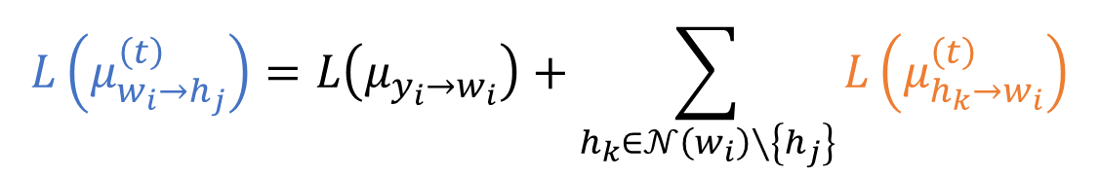
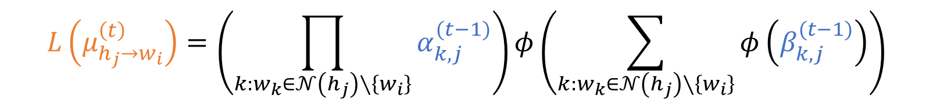
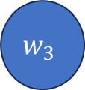

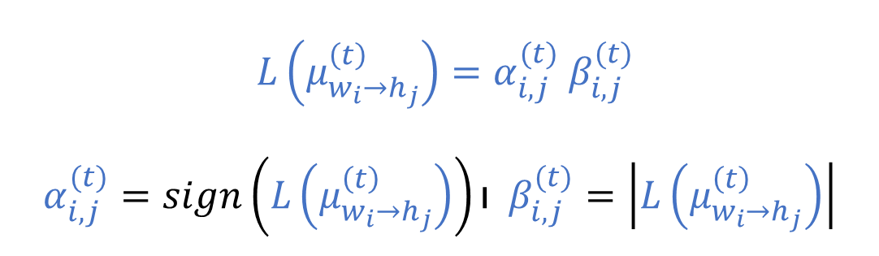
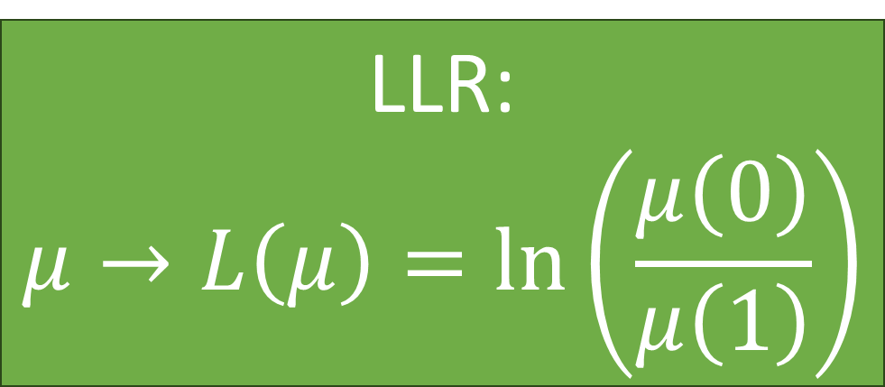





Message Passing
$$h_{1}$$
$$L\left(μ_{h_{j}→w_{i}}^{\left(t\right)}\right)=\left(\prod_{k:w_{k}∈𝒩\left(h_{j}\right)∖\left\{w_{i}\right\}}{α_{k,j}^{(t−1)}}\right)φ\left(\sum_{k:w_{k}∈𝒩\left(h_{j}\right)∖\left\{w_{i}\right\}}{φ\left(β_{k,j}^{(t−1)}\right)}\right)$$
$$μ_{h_{j}→w_{i}}^{\left(t\right)}\left(b\right)=Pr\left(check equation h_{j } is satisfied | w_{i}=b,M_{𝒲}\left(\sim i\right)\right)$$
$$μ_{w_{i}→h_{j}}^{\left(t\right)}\left(b\right)=Pr(w_{i}=b|y_{i},M_{ℋ}\left(\sim j\right))$$
$$L\left(μ_{w_{i}→h_{j}}^{\left(t\right)}\right)=L\left(μ_{{y_{i}→w}_{i}}\right)+\sum_{h_{k}∈𝒩\left(w_{i}\right)∖\left\{h_{j}\right\}}{L\left(μ_{h_{k}→w_{i}}^{\left(t\right)}\right)}$$
LLR:
$$μ→L\left(μ\right)=\ln\left(\frac{μ\left(0\right)}{μ\left(1\right)}\right)$$
$$b=0,1$$
$$w_{1}$$
$$w_{3}$$
$$w_{4}$$
$$w_{5}$$
$$h_{1}$$
$$h_{2}$$
$$h_{3}$$
$L\left(μ_{w_{i}→h_{j}}^{\left(t\right)}\right)=α_{i,j}^{(t)} β_{i,j}^{(t)}$
$$α_{i,j}^{(t)}=sign\left(L\left(μ_{w_{i}→h_{j}}^{\left(t\right)}\right)\right)ו β_{i,j}^{(t)}=\left|L\left(μ_{w_{i}→h_{j}}^{\left(t\right)}\right)\right|$$
$$w_{3}$$

Slide 7
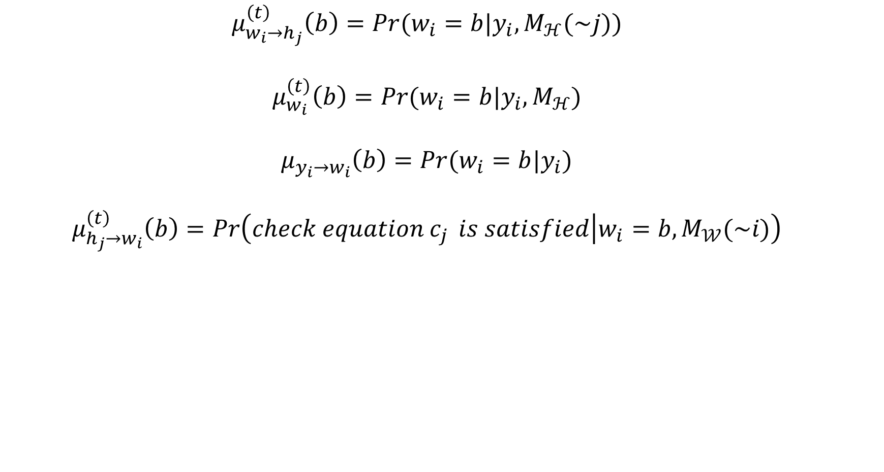
Message Passing Algorithm - 1
$$μ_{w_{i}→h_{j}}^{\left(t\right)}\left(b\right)=Pr(w_{i}=b|y_{i},M_{ℋ}(\sim j))$$
$$μ_{w_{i}}^{\left(t\right)}\left(b\right)=Pr(w_{i}=b|y_{i},M_{ℋ})$$
$$μ_{{y_{i}→w}_{i}}\left(b\right)=Pr(w_{i}=b|y_{i})$$
$$μ_{h_{j}→w_{i}}^{\left(t\right)}\left(b\right)=Pr\left(check equation c_{j } is satisfied | w_{i}=b,M_{𝒲}(\sim i)\right)$$

Slide 8
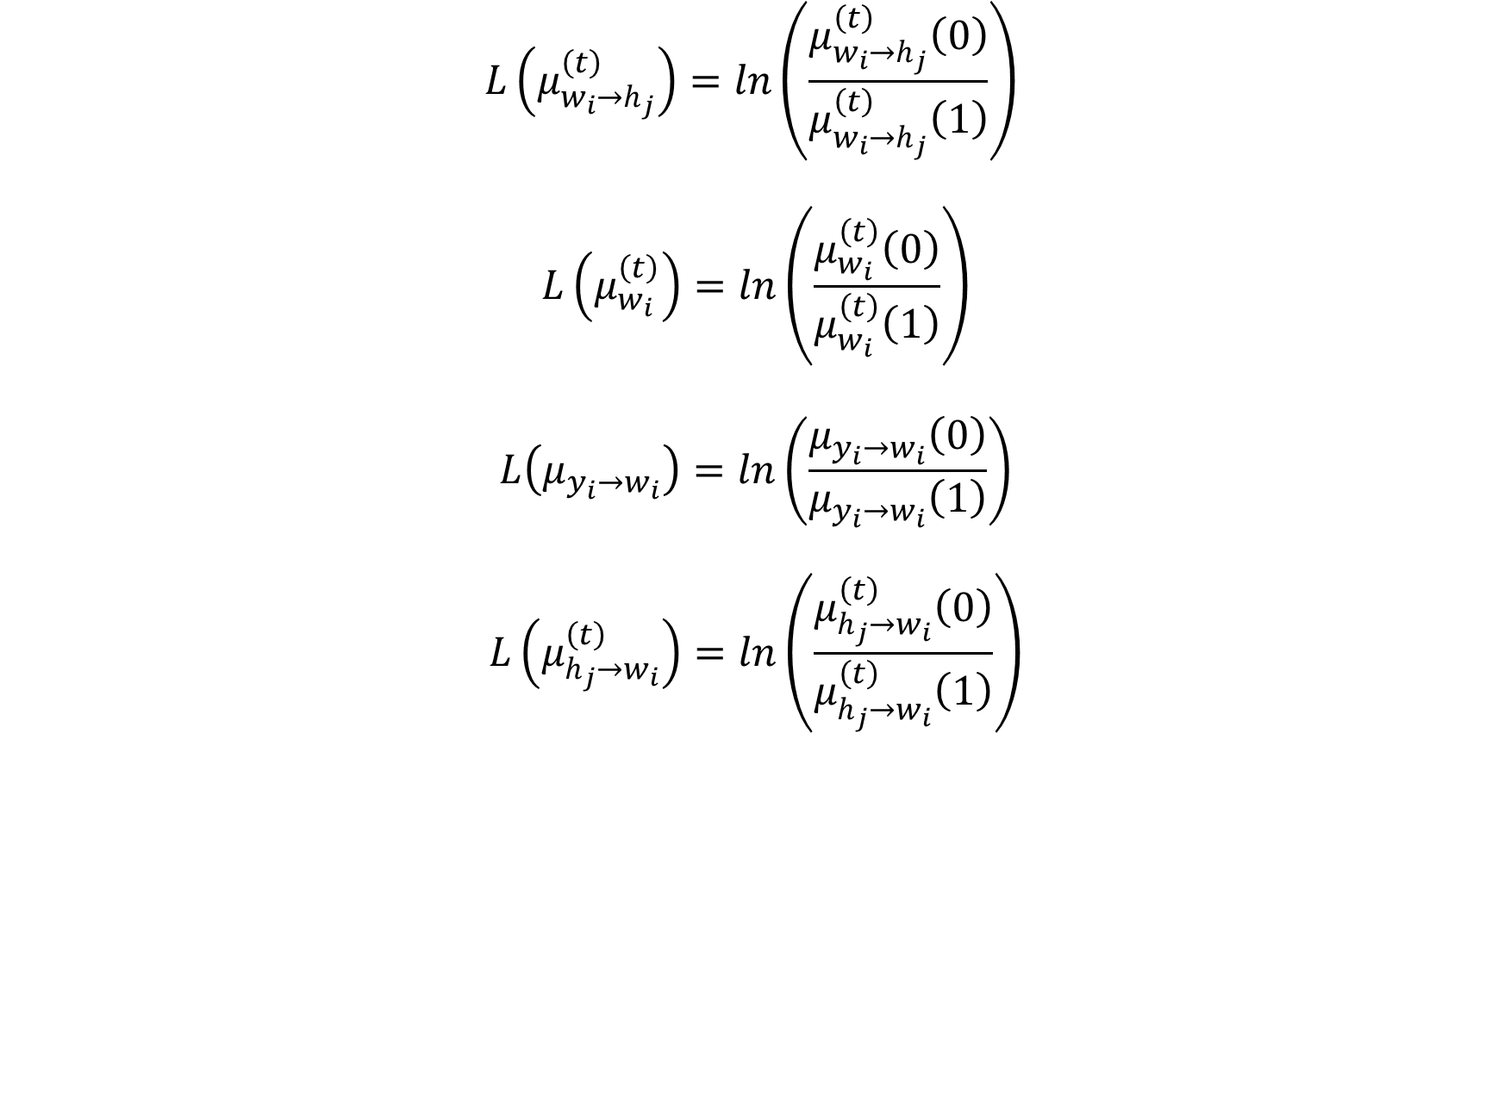
Message Passing Algorithm - 2
$$L\left(μ_{w_{i}→h_{j}}^{\left(t\right)}\right)=ln\left(\frac{μ_{w_{i}→h_{j}}^{\left(t\right)}\left(0\right)}{μ_{w_{i}→h_{j}}^{\left(t\right)}\left(1\right)}\right)$$
$$L\left(μ_{w_{i}}^{\left(t\right)}\right)=ln\left(\frac{μ_{w_{i}}^{\left(t\right)}\left(0\right)}{μ_{w_{i}}^{\left(t\right)}\left(1\right)}\right)$$
$$L\left(μ_{{y_{i}→w}_{i}}\right)=ln\left(\frac{μ_{{y_{i}→w}_{i}}\left(0\right)}{μ_{{y_{i}→w}_{i}}\left(1\right)}\right)$$
$$L\left(μ_{h_{j}→w_{i}}^{\left(t\right)}\right)=ln\left(\frac{μ_{h_{j}→w_{i}}^{\left(t\right)}\left(0\right)}{μ_{h_{j}→w_{i}}^{\left(t\right)}\left(1\right)}\right)$$

Slide 9
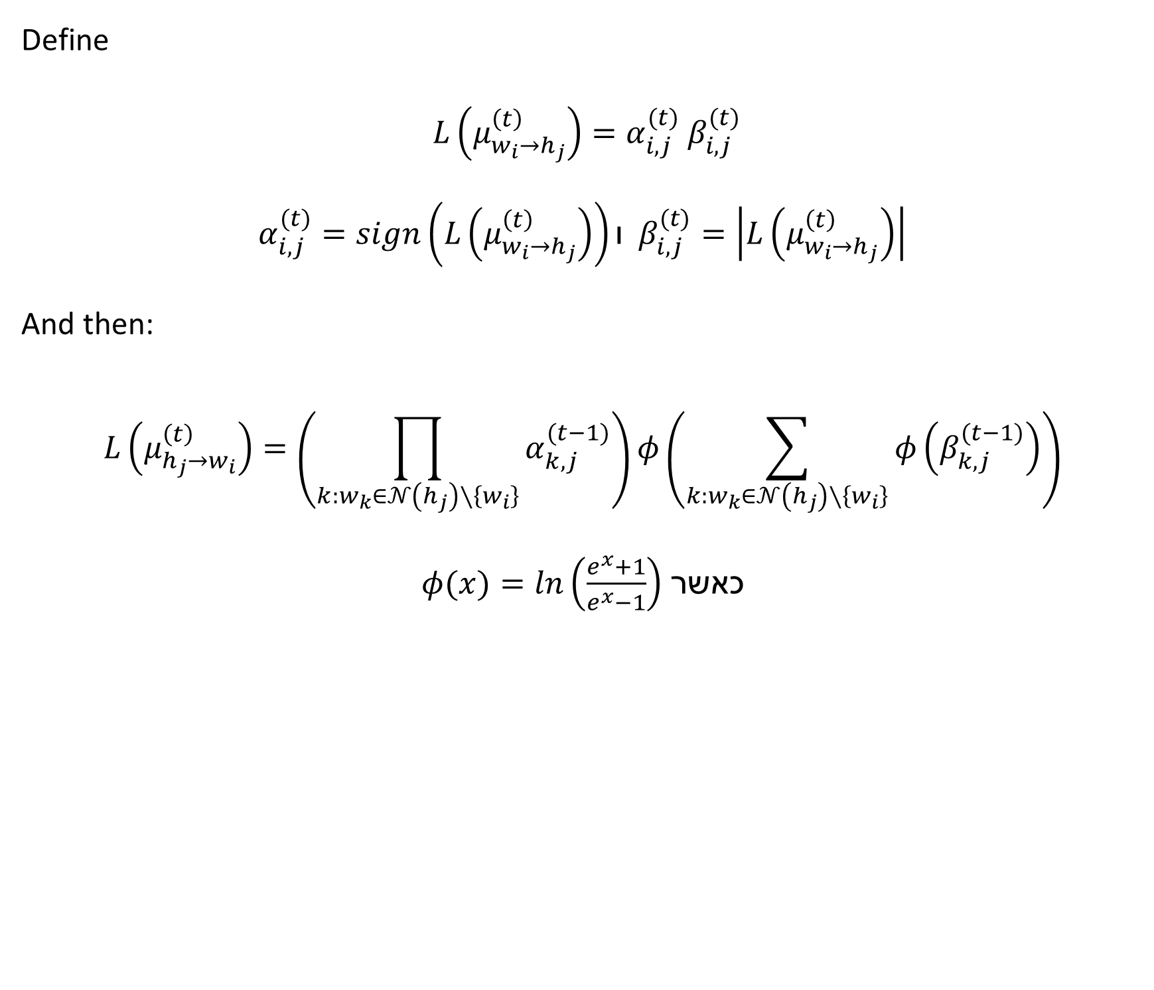
Message Passing Algorithm - 3
Define
$L\left(μ_{w_{i}→h_{j}}^{\left(t\right)}\right)=α_{i,j}^{(t)} β_{i,j}^{(t)}$
$$α_{i,j}^{(t)}=sign\left(L\left(μ_{w_{i}→h_{j}}^{\left(t\right)}\right)\right)ו β_{i,j}^{(t)}=\left|L\left(μ_{w_{i}→h_{j}}^{\left(t\right)}\right)\right|$$
And then:
$$L\left(μ_{h_{j}→w_{i}}^{\left(t\right)}\right)=\left(\prod_{k:w_{k}∈𝒩\left(h_{j}\right)∖\left\{w_{i}\right\}}{α_{k,j}^{(t−1)}}\right)φ\left(\sum_{k:w_{k}∈𝒩\left(h_{j}\right)∖\left\{w_{i}\right\}}{φ\left(β_{k,j}^{(t−1)}\right)}\right)$$
כאשר $φ(x)=ln\left(\frac{e^{x}+1}{e^{x}−1}\right)$

Slide 10
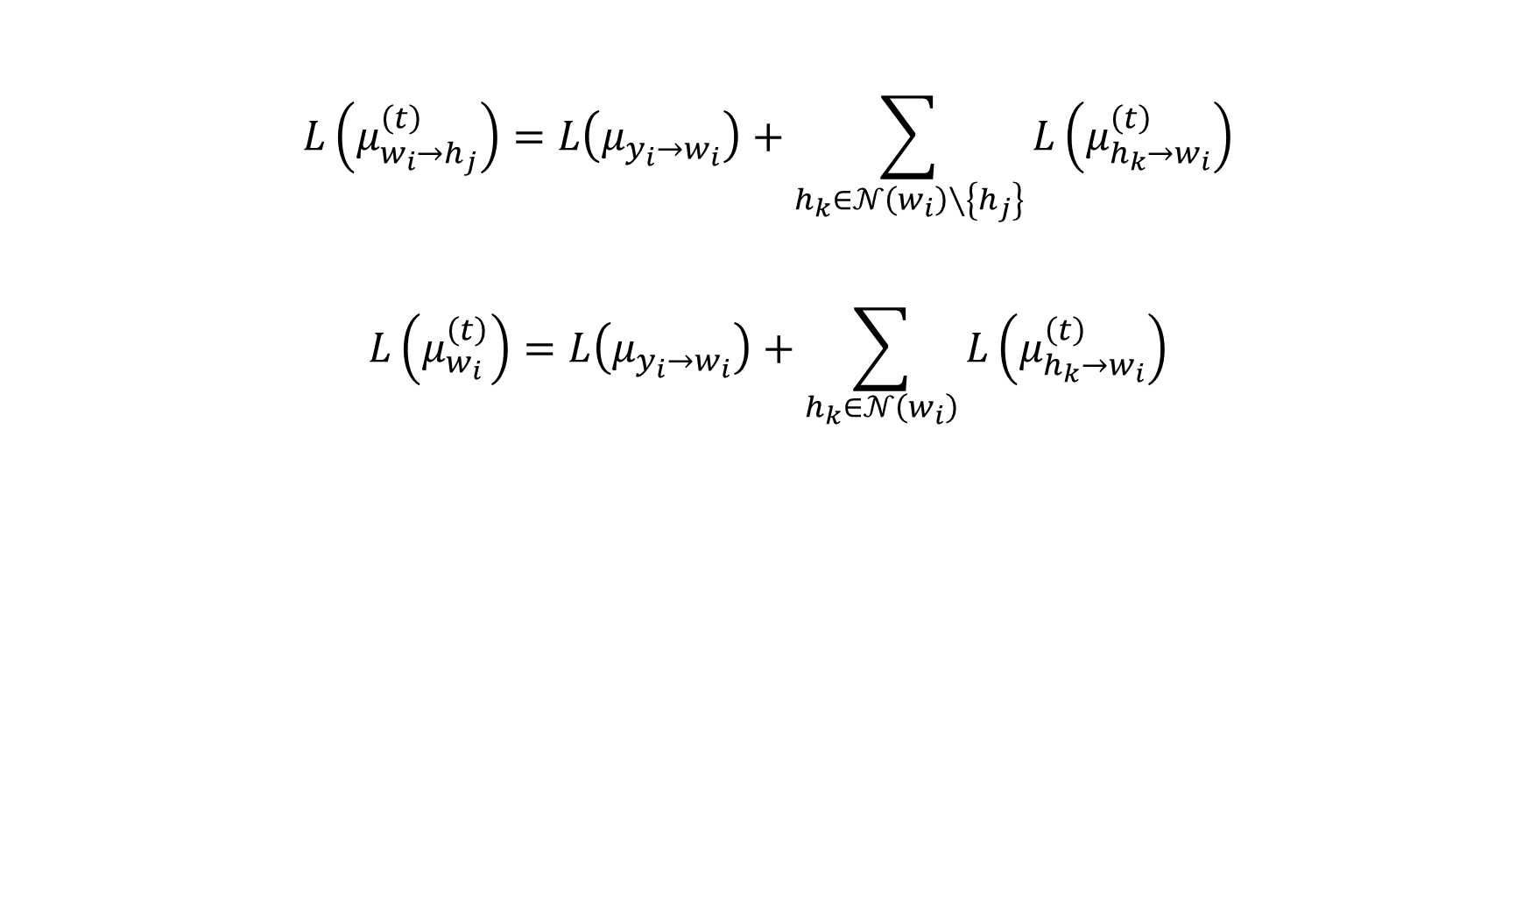
Message Passing Algorithm - 4
$$L\left(μ_{w_{i}→h_{j}}^{\left(t\right)}\right)=L\left(μ_{{y_{i}→w}_{i}}\right)+\sum_{h_{k}∈𝒩\left(w_{i}\right)∖\left\{h_{j}\right\}}{L\left(μ_{h_{k}→w_{i}}^{\left(t\right)}\right)}$$
$$L\left(μ_{w_{i}}^{\left(t\right)}\right)=L\left(μ_{{y_{i}→w}_{i}}\right)+\sum_{h_{k}∈𝒩\left(w_{i}\right)}{L\left(μ_{h_{k}→w_{i}}^{\left(t\right)}\right)}$$

Slide 11
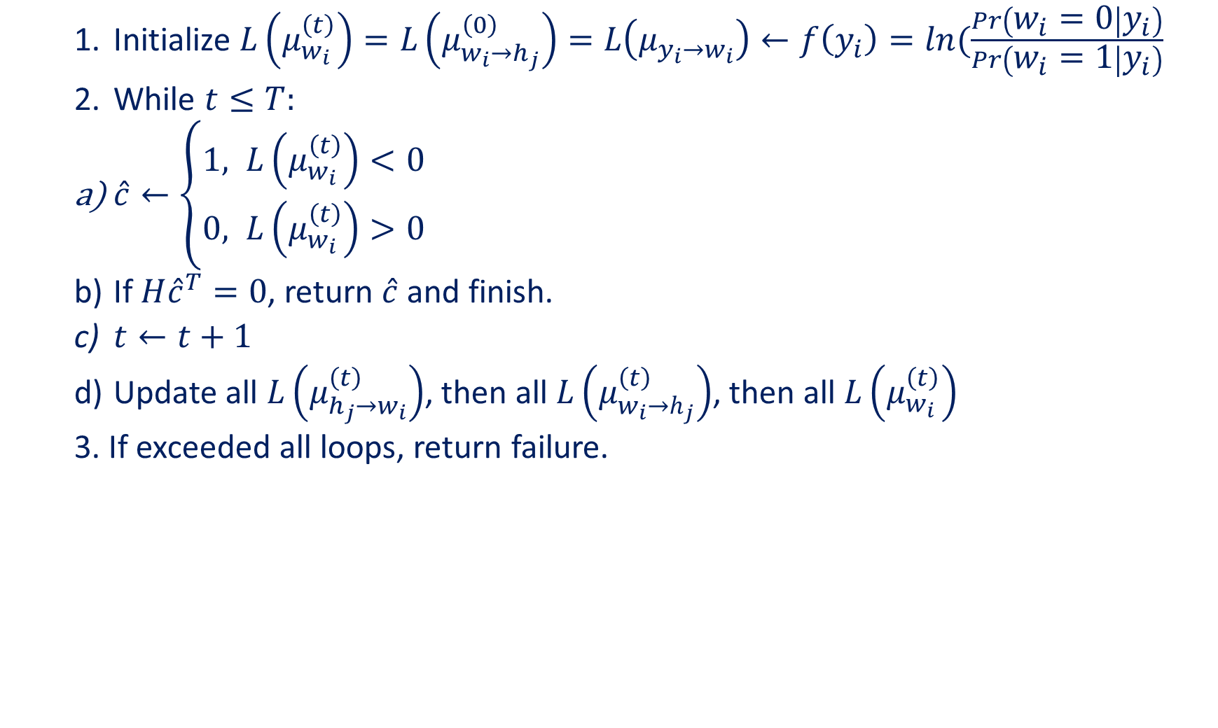
Message Passing Algorithm - 5
Initialize $L\left(μ_{w_{i}}^{\left(t\right)}\right)=L\left(μ_{w_{i}→h_{j}}^{\left(0\right)}\right)=L\left(μ_{{y_{i}→w}_{i}}\right)←f\left(y_{i}\right)=ln(\frac{Pr\left(w_{i}=0 | y_{i}\right)}{Pr\left(w_{i}=1 | y_{i}\right)}$
While $t≤T:$
$\hat{c}←\left\{\begin{aligned}1, &L\left(μ_{w_{i}}^{\left(t\right)}\right)<0 \\ 0, &L\left(μ_{w_{i}}^{\left(t\right)}\right)>0\end{aligned}\right.$
If $H{\hat{c}}^{T}=0$, return $\hat{c}$ and finish.
$t←t+1$
Update all $L\left(μ_{h_{j}→w_{i}}^{\left(t\right)}\right)$, then all $L\left(μ_{w_{i}→h_{j}}^{\left(t\right)}\right)$, then all $L\left(μ_{w_{i}}^{\left(t\right)}\right)$
3. If exceeded all loops, return failure.

Slide 12
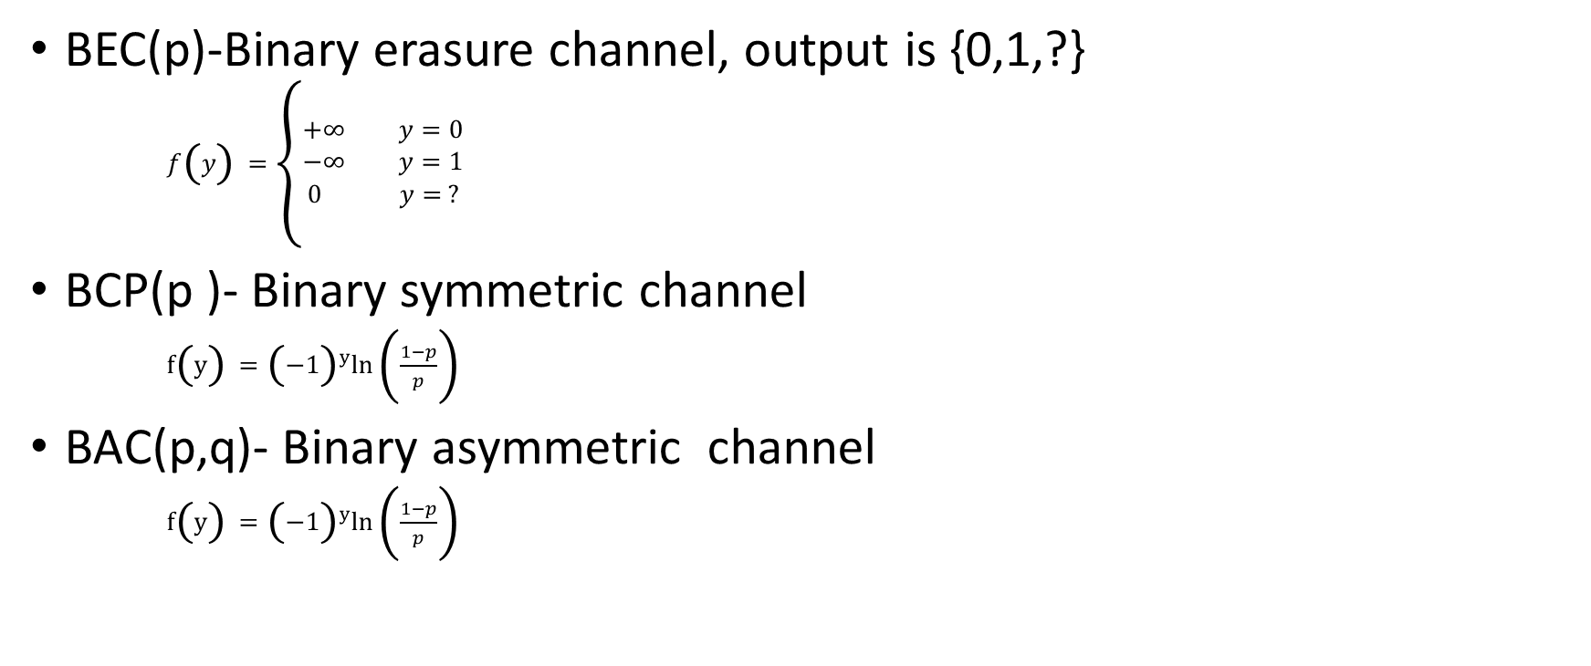
Probability of standard channels
BEC(p)-Binary erasure channel, output is {0,1,?}
$f\left(y\right)=\left\{\begin{aligned}+∞ y=0 \\ −∞ y=1 \\ 0 y= ?\end{aligned}\right.$
BCP(p )- Binary symmetric channel
$f\left(y\right)={\left(−1\right)}^{y}ln⁡\left(\frac{1−p}{p}\right)$
BAC(p,q)- Binary asymmetric channel
$f\left(y\right)={\left(−1\right)}^{y}ln⁡\left(\frac{1−p}{p}\right)$

Slide 13
Barrier Channel

Slide 14
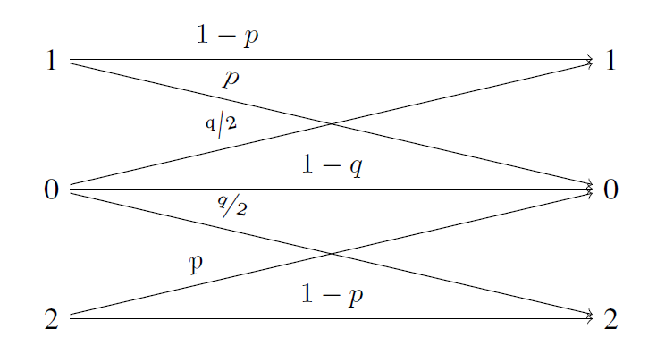
The Barrier Channel
Up error
Down error

Slide 15


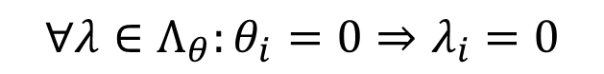

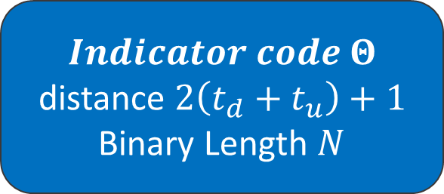

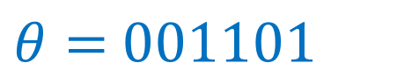



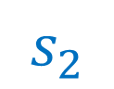
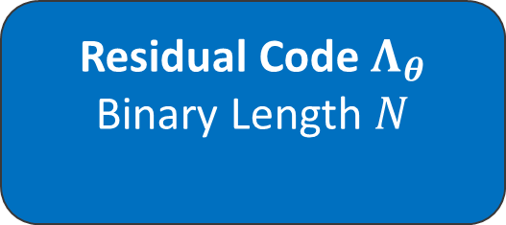

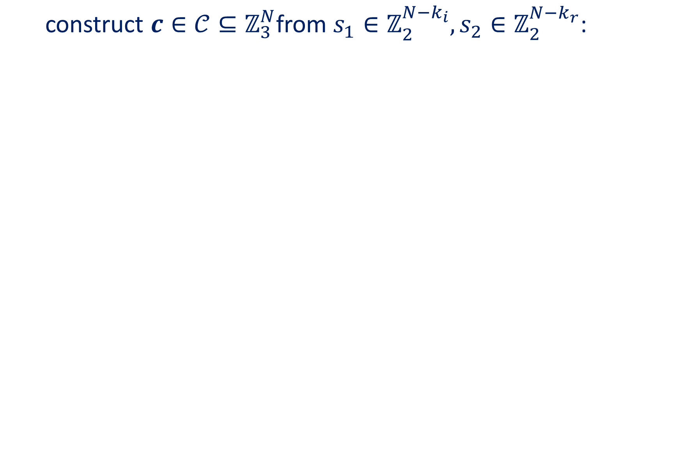
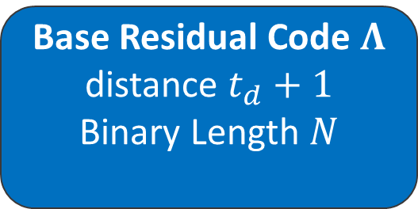
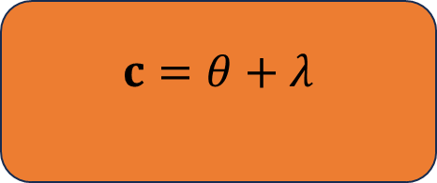
Construction of barrier ${(t}_{d},t_{u})−code$ $𝒞$
construct $c∈𝒞⊆ℤ_{3}^{N}$from $s_{1}∈ℤ_{2}^{N−k_{i}},s_{2}∈ℤ_{2}^{{N−k}_{r}}$:
$$s_{1}$$
$$Indicator code Θ$$
distance $2\left(t_{d}+t_{u}\right)+1$
Binary Length $N$
$θ=$ $001101$
Base Residual Code $Λ$
distance $t_{d}+1$
Binary Length $N$
$$θ$$
$$∀λ∈Λ_{θ}:θ_{i}=0⇒λ_{i}=0$$
$$s_{2}$$
$$c$$
Residual Code $Λ_{θ}$
Binary Length $N$
$$c=001202$$
$$λ =000101$$
$$c=θ+λ$$
$$λ$$
Notes:
לכל היותר טי-די וטי-יו שגיאות

Slide 16
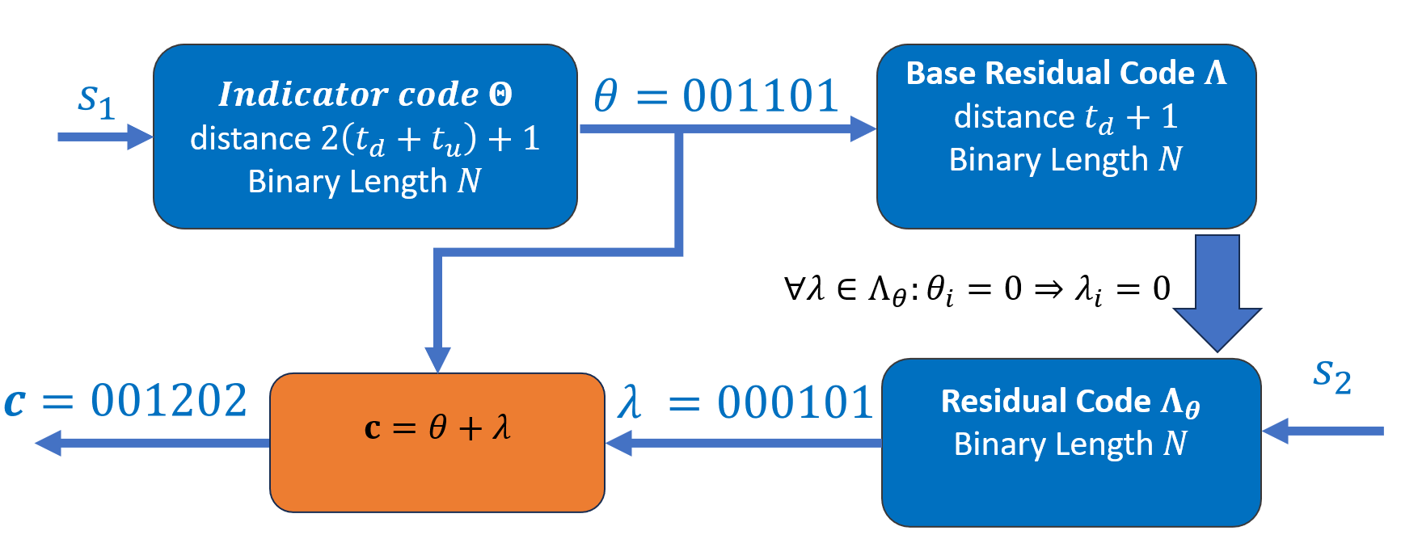
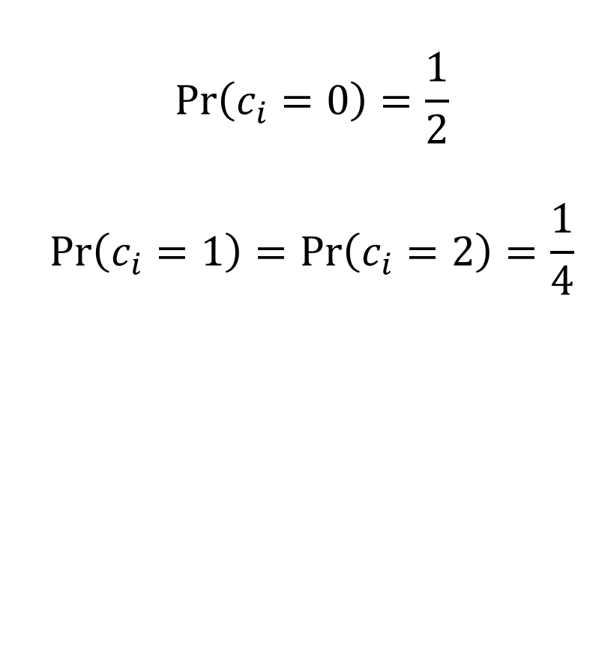
Barrier Code - Priors
$$\operatorname{Pr}\left(c_{i}=0\right)=\frac{1}{2}$$
$$\operatorname{Pr}\left(c_{i}=1\right)=\operatorname{Pr}\left(c_{i}=2\right)=\frac{1}{4}$$
11

Slide 17
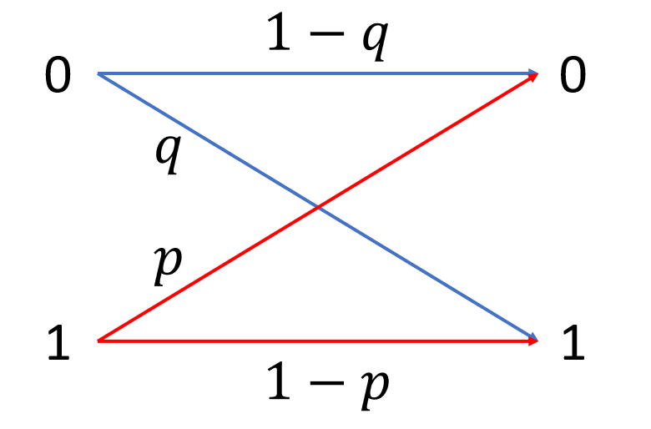
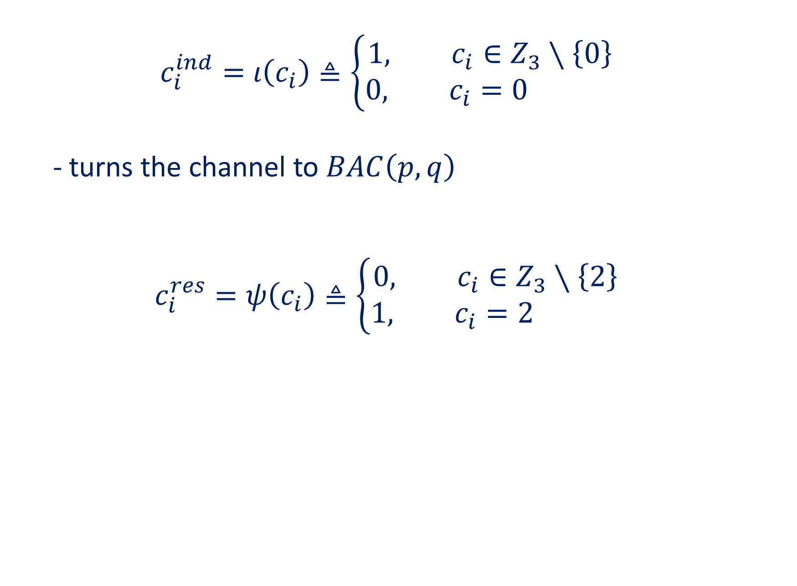
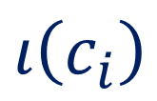
Indicator and Residual functions
$$c_{i}^{ind}=ι\left(c_{i}\right)≜\left\{\begin{aligned}1, c_{i}∈Z_{3}∖\left\{0\right\} \\ 0, c_{i}=0 \end{aligned}\right.$$
- turns the channel to $BAC\left(p,q\right)$
$$c_{i}^{res}=ψ\left(c_{i}\right)≜\left\{\begin{aligned}0, c_{i}∈Z_{3}∖\left\{2\right\} \\ 1, c_{i}=2 \end{aligned}\right.$$
$$ι\left(c_{i}\right)$$
$$⇒c=c^{ind}+c^{res}$$
10

Slide 18




$$1−q$$
0
0
$$q$$
$$p$$
1
1
$$1−p$$

Slide 19




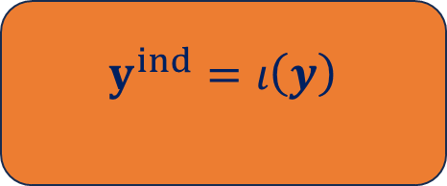

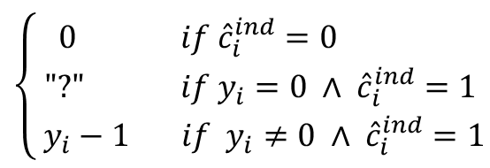
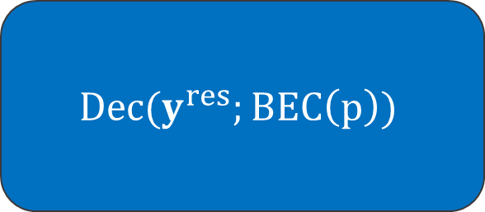
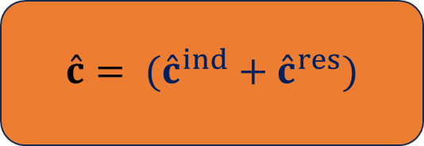





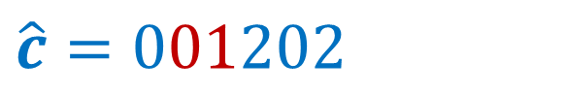
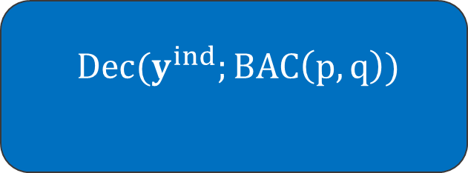





Standard Decoding
$$c=001202$$
$$c$$
$$y^{ind}=010101$$
$$y=020202$$
$$y^{ind}$$
$$Dec(y^{ind};BAC\left(p,q\right))$$
$$y$$
$$y^{ind}=ι\left(y\right)$$
$${\hat{c}}^{ind}$$
$${\hat{c}}^{ind}=001101$$
$$Dec(y^{res};BEC\left(p\right))$$
$$mapper$$
$$y^{res}=00?101$$
$$y^{res}$$
$$\left\{\begin{aligned}0 if {\hat{c}}_{i}^{ind}=0 \\ \text{"?"} if y_{i}=0 ∧ {\hat{c}}_{i}^{ind}=1 \\ y_{i}−1 if y_{i}≠0 ∧ {\hat{c}}_{i}^{ind}=1\end{aligned}\right.$$
$${\hat{c}}^{ind}$$
$$\hat{c}= ({\hat{c}}^{ind}+{\hat{c}}^{res})$$
$$\hat{c}$$
$${\hat{c}}^{res}$$
$${\hat{c}}^{res}=000101$$
$$\hat{c}=001202$$
12

Slide 20

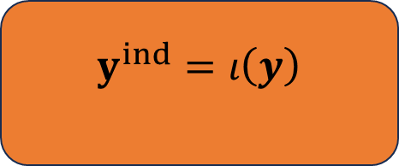
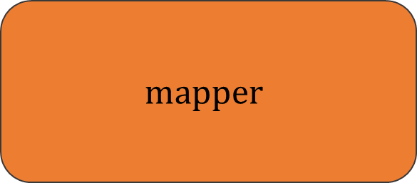


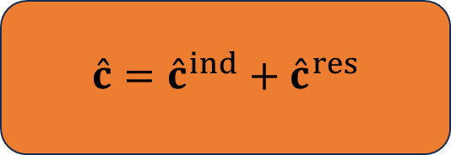

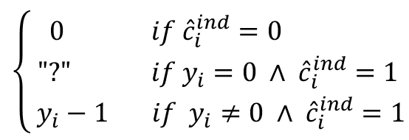


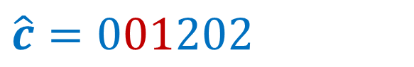



Standard Decoding
$$c=001202$$
$$c$$
$$y^{ind}=010101$$
$$y=020202$$
$$y^{ind}$$
$$Dec(y^{ind};BAC\left(p,q\right))$$
$$y$$
$$y^{ind}=ι\left(y\right)$$
$${\hat{c}}^{ind}=001101$$
$${\hat{c}}^{ind}$$
$$mapper$$
$$Dec(y^{res};BEC\left(p\right))$$
$$\left\{\begin{aligned}0 if {\hat{c}}_{i}^{ind}=0 \\ \text{"?"} if y_{i}=0 ∧ {\hat{c}}_{i}^{ind}=1 \\ y_{i}−1 if y_{i}≠0 ∧ {\hat{c}}_{i}^{ind}=1\end{aligned}\right.$$
$$y^{res}=00?101$$
$${\hat{c}}^{res}=000101$$
$$y^{res}$$
$${\hat{c}}^{res}$$
$$\hat{c}={\hat{c}}^{ind}+{\hat{c}}^{res}$$
$$\hat{c}$$
$$\hat{c}=001202$$
$$\hat{c}$$
12

Slide 21
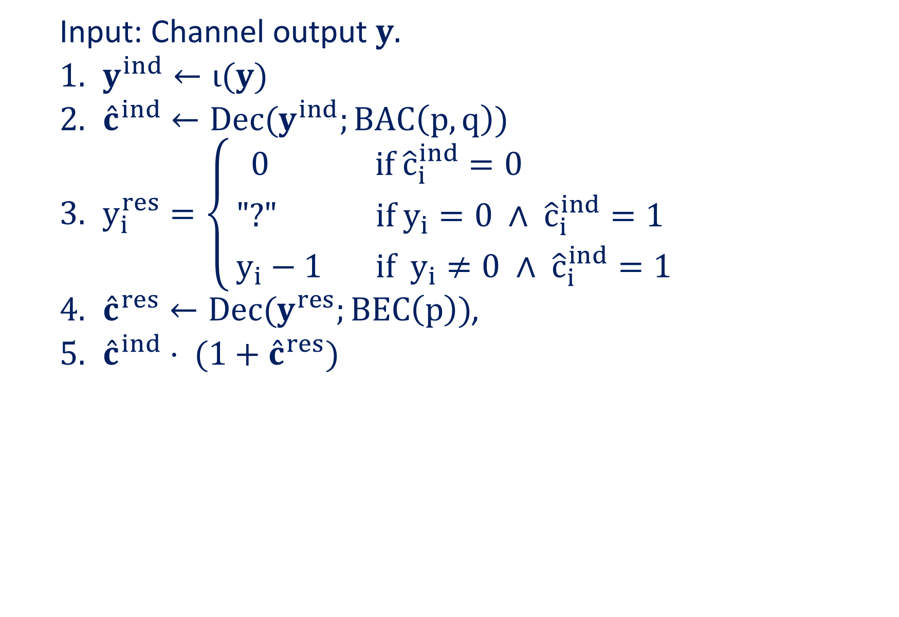
Standard Decoding
Input: Channel output $y.$
$y^{ind}←ι(y)$
${\hat{c}}^{ind}←Dec(y^{ind};BAC\left(p,q\right))$
$y_{i}^{res}=\left\{\begin{aligned}0 if {\hat{c}}_{i}^{ind}=0 \\ \text{"?"} if y_{i}=0 ∧ {\hat{c}}_{i}^{ind}=1 \\ y_{i}−1 if y_{i}≠0 ∧ {\hat{c}}_{i}^{ind}=1\end{aligned}\right.$
${\hat{c}}^{res}←Dec(y^{res};BEC\left(p\right))$,
${\hat{c}}^{ind}⋅ (1+{\hat{c}}^{res})$

Slide 22
LDPC-Barrier
Notes:
הסבר בעל פה שהבנייה הקודמת שהשתמשה בשני קודים עכשיו הופכת לבנייה ע"י 2 מטריצות בדיקת זוגיות
אפשר לשתמש גם בשקף 22

Slide 23
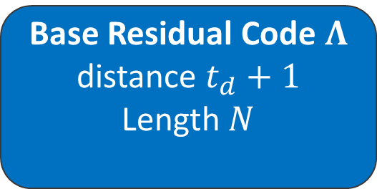
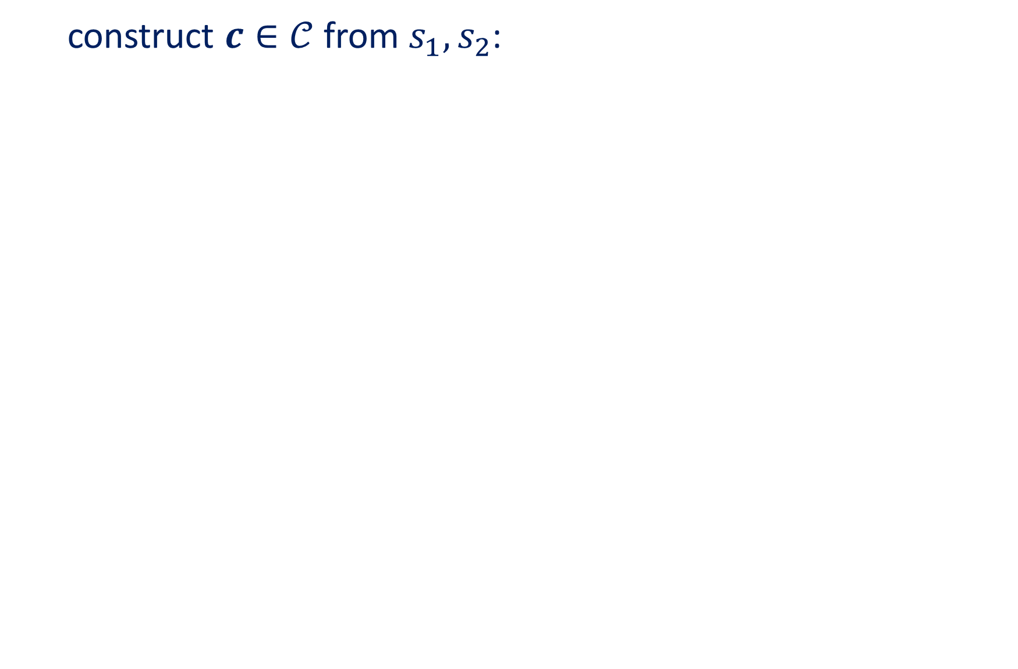


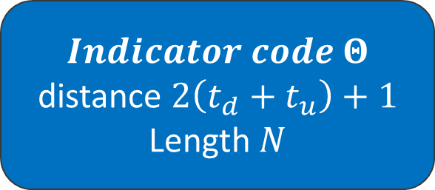



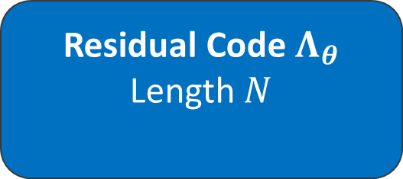
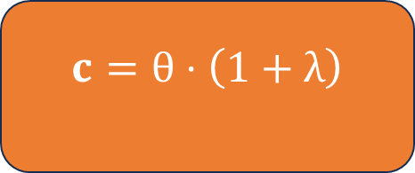
Construction of ${(t}_{d},t_{u})$ barrier code $𝒞$ Recall
construct $c∈𝒞$ from $s_{1},s_{2}$:
$$s_{1}$$
$$Indicator code Θ$$
distance $2\left(t_{d}+t_{u}\right)+1$
Length $N$
$$θ$$
Base Residual Code $Λ$
distance $t_{d}+1$
Length $N$
$$θ$$
$$∀λ∈Λ_{θ}:θ_{i}=0⇒λ_{i}=0$$
$$s_{2}$$
$$c$$
$$λ$$
Residual Code $Λ_{θ}$
Length $N$
$$c=θ⋅\left(1+λ\right)$$

Slide 24

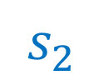









Construction of ${(t}_{d},t_{u})$ LDPC-barrier code $𝒞$
construct $c∈𝒞$ from $s_{1},s_{2}$:
$$s_{1}$$
$$Indicator code Θ$$
distance $2\left(t_{d}+t_{u}\right)+1$
Length $N$, PCM $H$
$$θ=s_{1}G_{H}$$
Base Residual Code $Λ$
distance $t_{d}+1$
Length $N$, PCM $U$
$$U_{θ}=\left({ι\left(θ\right)⋅U \atop {\left({\left(I_{n}\right)}_{\left[n\right]∖ω^{\left(θ\right)}}\right)}^{T}}\right)$$
$$θ$$
$$c$$
Residual Code $Λ_{θ}$
Length $N$, PCM $U_{θ}$
$$s_{2}$$
$$c=θ⋅\left(1+λ\right)$$
$$λ=s_{2}G_{U_{θ}}$$

Slide 25

Standard Decoding of LDPC-Barrier code
Input: Channel output $y.$
$y^{ind}←ι(y)$
${\hat{c}}^{ind}←LDPC−Dec(y^{ind};BAC\left(p,q\right))$
$y_{i}^{res}=\left\{\begin{aligned}0 if {\hat{c}}_{i}^{ind}=0 \\ \text{"?"} if y_{i}=0 ∧ {\hat{c}}_{i}^{ind}=1 \\ y_{i}−1 if y_{i}≠0 ∧ {\hat{c}}_{i}^{ind}=1\end{aligned}\right.$
${\hat{c}}^{res}←LDPC−Dec(y^{res};BEC\left(p\right))$,
${\hat{c}}^{ind}⋅ (1+{\hat{c}}^{res})$

Slide 26






LDPC-Barrier Code
LDPC-Barrier encoder
Indicator PCM $H∈ℱ_{2}^{n−k_{i}×n}$
Residual PCM$U∈ℱ_{2}^{n−k_{r}×n}$
$$s_{1},s_{2}$$
$$c$$
$$s.t: Hι\left(c^{T}\right)=0∧Uψ\left(c^{T}\right)=0$$
$$y^{ind}=ι\left(y\right)≜\left\{\begin{aligned}1, y∈Z_{3}∖\left\{0\right\} \\ 0, y=0 \end{aligned}\right.$$
$$y^{res}=ψ\left(y\right)≜\left\{\begin{aligned}0, y∈Z_{3}∖\left\{2\right\} \\ 1, y=2 \end{aligned}\right.$$
14

Slide 27

LDPC-Barrier Code
Input:
Indicator PCM $H∈ℱ_{2}^{n−k_{i}×n}$, Residual PCM$U∈ℱ_{2}^{n−k_{r}×n}$
$s_{1}∈ℱ_{2}^{k_{i}},s_{2}∈ℱ_{2}^{k_{r}}$
Output:
A codeword $c$ s.t :$Hι\left(c^{T}\right)=0$ and $Uψ\left(c^{T}\right)=0$.
$$y^{ind}=ι\left(y\right)≜\left\{\begin{aligned}1, y∈Z_{3}∖\left\{0\right\} \\ 0, y=0 \end{aligned}\right.$$
$$y^{res}=ψ\left(y\right)≜\left\{\begin{aligned}0, y∈Z_{3}∖\left\{2\right\} \\ 1, y=2 \end{aligned}\right.$$

Slide 28

LDPC-barrier Code - 2
Algorithm:
$θ=s_{1}G_{H}$
2. $U_{θ}=\left({ι\left(θ\right)⋅U \atop {\left({\left(I_{n}\right)}_{\left[n\right]∖ω^{\left(θ\right)}}\right)}^{T}}\right)$
3. $λ=s_{2}G_{U_{θ}}$
4. $c=θ⋅\left(1+λ\right)$

Slide 29



LDPC-barrier code as Dual Bipartite Graph
Edge $\left\{w_{i},h_{j}\right\}$ exist if $H_{i,j}≠0$ (Indicator PCM)
Edge $\left\{w_{i},u_{j}\right\}$ exist if $U_{i,j}≠0$ (Residual PCM)
$$Hι\left(c^{T}\right)=0$$
$$Uψ\left(c^{T}\right)=0$$
$$ι\left(⋅\right)$$
$$ψ\left(⋅\right)$$
Notes:
כאן הסבר אינטואיטיבי שהמפענח הסטנדרטי עושה קודם כל את הצד העליון ואז את הצד התחתון
אבל מפסידים בכך את ההשפעה של הרזידואל על האינדיקטור (לדוגמה אם יש אינדיקציה חזקה מהרזידואל שהביט שווה ל 1 אזי הסימבול בהכרח שווה ל 2, ולכן פונקציית האינדיקטור על הסימבול בהכרח שווה ל1 .
אפשר גם להסביר פה שהמשוואות של קודקודי בדיקת הזוגיות לא השתנו בכלל, רק הפעם הם מקבלים את ה"ללר" של הפונקצייה אינדיקטור\רזידואל
להסביר על סיקוונס

Slide 30







Decoding of LDPC-Barrier
Cooperative
Standard
$${\hat{c}}^{ind}$$
Message Passing $S_{ind} iters$
$$y^{ind}=ι\left(y\right)$$
Message Passing
$$y$$
Message Passing
Message Passing $S_{res} iters$
$$y^{res}$$
$${\hat{c}}^{res}$$
Notes:
כאן הסבר אינטואיטיבי שהמפענח הסטנדרטי עושה קודם כל את הצד העליון ואז את הצד התחתון
אבל מפסידים בכך את ההשפעה של הרזידואל על האינדיקטור (לדוגמה אם יש אינדיקציה חזקה מהרזידואל שהביט שווה ל 1 אזי הסימבול בהכרח שווה ל 2, ולכן פונקציית האינדיקטור על הסימבול בהכרח שווה ל1 .
אפשר גם להסביר פה שהמשוואות של קודקודי בדיקת הזוגיות לא השתנו בכלל, רק הפעם הם מקבלים את ה"ללר" של הפונקצייה אינדיקטור\רזידואל
להסביר על סיקוונס

Slide 31














Cooperative Message Passing
$$h_{1}$$
$$h_{3}$$
$$m_{u_{j}→w_{i}}^{\left(t\right)}\left(b\right)=Pr\left(check equation u_{j } is satisfied | ψ\left(w_{i}\right)=b,M_{𝒲}(\sim i)\right)$$
$$L\left(m_{w_{i}→u_{j}}^{\left(t\right)}\right)=$$
$$L\left(m_{{y_{i}→w}_{i}}\right)+\sum_{u_{k}∈𝒩_{𝒰}\left(w_{i}\right)∖\left\{u_{j}\right\}}{L\left(m_{u_{k}→w_{i}}^{\left(t\right)}\right)}+\sum_{h_{l}∈𝒩_{ℋ}\left(w_{i}\right)}{\ln\left(1+2e^{L\left(μ_{h_{l}→w_{i}}^{\left(t\right)}\right)}\right)}$$
$$w_{3}$$
$$m_{w_{i}→u_{j}}^{\left(t\right)}\left(b\right)=Pr\left({ψ(w}_{i}\right)=b|y_{i},M_{ℋ},M_{𝒰}\left(\sim j\right))$$
$$b=0,1$$
$$u_{1}$$
$$u_{2}$$
$$u_{3}$$
$$h_{1}$$
$$h_{3}$$
$$L\left(μ_{w_{i}→h_{j}}^{\left(t\right)}\right)=$$
$$L\left(μ_{{y_{i}→w}_{i}}\right)+\sum_{h_{k}∈𝒩_{ℋ}\left(w_{i}\right)∖\left\{h_{j}\right\}}{L\left(μ_{h_{k}→w_{i}}^{\left(t\right)}\right)}+\sum_{u_{l}∈𝒩_{𝒰}\left(w_{i}\right)}{−\ln\left(1+2e^{−L\left(m_{u_{l}→w_{i}}^{\left(t\right)}\right)}\right)}$$
$$w_{3}$$
$$μ_{h_{j}→w_{i}}^{\left(t\right)}\left(b\right)=Pr\left(check equation h_{j } is satisfied | ι\left(w_{i}\right)=b,M_{𝒲}(\sim i)\right)$$
$$μ_{w_{i}→h_{j}}^{\left(t\right)}\left(b\right)=Pr\left({ι(w}_{i}\right)=b|y_{i},M_{ℋ}\left(\sim j\right),M_{𝒰})$$
$$u_{1}$$
$$u_{2}$$
$$u_{3}$$
$$b=0,1$$
17

Slide 32
Cooperative Message Passing
$$h_{1}$$
$$h_{3}$$
$$μ_{h_{j}→w_{i}}^{\left(t\right)}\left(b\right)=Pr\left(check equation h_{j } is satisfied | ι\left(w_{i}\right)=b,M_{𝒲}(\sim i)\right)$$
$$m_{u_{j}→w_{i}}^{\left(t\right)}\left(b\right)=Pr\left(check equation u_{j } is satisfied | ψ\left(w_{i}\right)=b,M_{𝒲}(\sim i)\right)$$
$$w_{3}$$
$$m_{w_{i}→u_{j}}^{\left(t\right)}\left(b\right)=Pr\left({ψ(w}_{i}\right)=b|y_{i},M_{ℋ},M_{𝒰}\left(\sim j\right))$$
$$μ_{w_{i}→h_{j}}^{\left(t\right)}\left(b\right)=Pr\left({ι(w}_{i}\right)=b|y_{i},M_{ℋ}\left(\sim j\right),M_{𝒰})$$
$$u_{1}$$
$$u_{2}$$
$$u_{3}$$
$$h_{1}$$
$$h_{3}$$
$$b=0,1$$
$$L\left(m_{w_{i}→u_{j}}^{\left(t\right)}\right)=L\left(m_{{y_{i}→w}_{i}}\right)+\sum_{u_{k}∈𝒩_{𝒰}\left(w_{i}\right)∖\left\{u_{j}\right\}}{L\left(m_{u_{k}→w_{i}}^{\left(t\right)}\right)}+\sum_{h_{l}∈𝒩_{ℋ}\left(w_{i}\right)}{\ln\left(1+2e^{L\left(μ_{h_{l}→w_{i}}^{\left(t\right)}\right)}\right)}$$
$$w_{3}$$
$$L\left(μ_{w_{i}→h_{j}}^{\left(t\right)}\right)=L\left(μ_{{y_{i}→w}_{i}}\right)+\sum_{h_{k}∈𝒩_{ℋ}\left(w_{i}\right)∖\left\{h_{j}\right\}}{L\left(μ_{h_{k}→w_{i}}^{\left(t\right)}\right)}+\sum_{u_{l}∈𝒩_{𝒰}\left(w_{i}\right)}{−\ln\left(1+2e^{−L\left(m_{u_{l}→w_{i}}^{\left(t\right)}\right)}\right)}$$
$$u_{1}$$
$$u_{2}$$
$$u_{3}$$
17

Slide 33

Message Passing Cooperative Algorithm - General
Iterative non-optimal algorithm.
Messages are passed between nodes on the Dual Bipartite Graph.
Loop of A Indicator steps and B Residual steps, written as sequence = [A,B]
Messages are log-likelihood of probabilities of bits to be 0\1, and of probabilities of check nodes to be solved given bits are 0\1.

Slide 34


Message Passing Cooperative Algorithm – 1
Indicator
Residual
$μ_{w_{i}→h_{j}}^{\left(t\right)}\left(b\right)=\operatorname{Pr}\left(ι\left(w_{i}\right)=b | y_{i},M_{ℋ}\left(\sim j\right),M_{𝒰}\right)$
$μ_{w_{i}}^{\left(t\right)}\left(b\right)=\operatorname{Pr}\left(ι\left(w_{i}\right)=b | y_{i},M_{ℋ},M_{𝒰}\right)$
$μ_{{y_{i}→w}_{i}}\left(b\right)=Pr(ι\left(w_{i}\right)=b|y_{i})$
$μ_{h_{j}→w_{i}}^{\left(t\right)}\left(b\right)=\operatorname{Pr}\left(check equation h_{j } is satisfied | ι\left(w_{i}\right)=b,M_{𝒲→ℋ}\left(\sim i\right)\right)$
$m_{w_{i}→u_{j}}^{\left(t\right)}\left(b\right)=\operatorname{Pr}\left(ψ\left(w_{i}\right)=b | y_{i},M_{𝒰}\left(\sim j\right),M_{ℋ}\right)$
$m_{w_{i}}^{\left(t\right)}\left(b\right)=\operatorname{Pr}\left(ψ\left(w_{i}\right)=b | y_{i},M_{ℋ},M_{𝒰}\right)$
$m_{{y_{i}→w}_{i}}\left(b\right)=Pr(ψ\left(w_{i}\right)=b|y_{i})$
$m_{u_{j}→w_{i}}^{\left(t\right)}\left(b\right)=\operatorname{Pr}\left(check equation u_{j } is satisfied | ψ\left(w_{i}\right)=b,M_{𝒲→𝒰}\left(\sim i\right)\right)$

Slide 35


Message Passing Cooperative Algorithm – 2
Indicator
Residual
$L\left(μ_{w_{i}→h_{j}}^{\left(t\right)}\right)=ln\left(\frac{μ_{w_{i}→h_{j}}^{\left(t\right)}\left(0\right)}{μ_{w_{i}→h_{j}}^{\left(t\right)}\left(1\right)}\right)$
$L\left(μ_{w_{i}}^{\left(t\right)}\right)=ln\left(\frac{μ_{w_{i}}^{\left(t\right)}\left(0\right)}{μ_{w_{i}}^{\left(t\right)}\left(1\right)}\right)$
$L\left(μ_{{y_{i}→w}_{i}}\right)=ln\left(\frac{μ_{{y_{i}→w}_{i}}\left(0\right)}{μ_{{y_{i}→w}_{i}}\left(1\right)}\right)$
$L\left(μ_{h_{j}→w_{i}}^{\left(t\right)}\right)=ln\left(\frac{μ_{h_{j}→w_{i}}^{\left(t\right)}\left(0\right)}{μ_{h_{j}→w_{i}}^{\left(t\right)}\left(1\right)}\right)$
$L\left(m_{w_{i}→u_{j}}^{\left(t\right)}\right)=ln\left(\frac{m_{w_{i}→u_{j}}^{\left(t\right)}\left(0\right)}{m_{w_{i}→u_{j}}^{\left(t\right)}\left(1\right)}\right)$
$L\left(m_{w_{i}}^{\left(t\right)}\right)=ln\left(\frac{m_{w_{i}}^{\left(t\right)}\left(0\right)}{m_{w_{i}}^{\left(t\right)}\left(1\right)}\right)$
$L\left(m_{{y_{i}→w}_{i}}\right)=ln\left(\frac{m_{{y_{i}→w}_{i}}\left(0\right)}{m_{{y_{i}→w}_{i}}\left(1\right)}\right)$
$L\left(m_{u_{j}→w_{i}}^{\left(t\right)}\right)=ln\left(\frac{m_{u_{j}→w_{i}}^{\left(t\right)}\left(0\right)}{m_{u_{j}→w_{i}}^{\left(t\right)}\left(1\right)}\right)$

Slide 36


Message Passing Cooperative Algorithm – 3
Indicator
Residual
Define $L\left(μ_{w_{i}→h_{j}}^{\left(t\right)}\right)=α_{i,j}^{(t)} β_{i,j}^{(t)}$
$$α_{i,j}^{(t)}=sign\left(L\left(μ_{w_{i}→h_{j}}^{\left(t\right)}\right)\right)ו β_{i,j}^{(t)}=\left|L\left(μ_{w_{i}→h_{j}}^{\left(t\right)}\right)\right|$$
And then
$$L\left(μ_{h_{j}→w_{i}}^{\left(t\right)}\right)=\left(\prod_{k:w_{k}∈𝒩\left(h_{j}\right)∖\left\{w_{i}\right\}}{α_{k,j}^{(t−1)}}\right)φ\left(\sum_{k:w_{k}∈𝒩\left(h_{j}\right)∖\left\{w_{i}\right\}}{φ\left(β_{k,j}^{(t−1)}\right)}\right)$$
Such that $φ(x)=ln\left(\frac{e^{x}+1}{e^{x}−1}\right)$
Define $L\left(m_{w_{i}→u_{j}}^{\left(t\right)}\right)=γ_{i,j}^{(t)} δ_{i,j}^{(t)}$
$$γ_{i,j}^{(t)}=sign\left(L\left(m_{w_{i}→u_{j}}^{\left(t\right)}\right)\right)ו β_{i,j}^{(t)}=\left|L\left(m_{w_{i}→u_{j}}^{\left(t\right)}\right)\right|$$
And then
$$L\left(m_{u_{j}→w_{i}}^{\left(t\right)}\right)=\left(\prod_{k:w_{k}∈𝒩\left(u_{j}\right)∖\left\{w_{i}\right\}}{γ_{k,j}^{(t−1)}}\right)φ\left(\sum_{k:w_{k}∈𝒩\left(u_{j}\right)∖\left\{w_{i}\right\}}{φ\left(δ_{k,j}^{(t−1)}\right)}\right)$$

Slide 37


Message Passing Cooperative Algorithm – 4
Indicator
Residual
$L\left(μ_{w_{i}→h_{j}}^{\left(t\right)}\right)=L\left(μ_{{y_{i}→w}_{i}}\right)+\sum_{h_{k}∈𝒩_{ℋ}\left(w_{i}\right)∖\left\{h_{j}\right\}}{L\left(μ_{h_{k}→w_{i}}^{\left(t\right)}\right)}+\sum_{u_{l}∈𝒩_{𝒰}\left(w_{i}\right)}{−\ln\left(1+2e^{−L\left(m_{u_{l}→w_{i}}^{\left(t\right)}\right)}\right)}$
$L\left(μ_{w_{i}}^{\left(t\right)}\right)=L\left(μ_{{y_{i}→w}_{i}}\right)+\sum_{h_{k}∈𝒩\left(w_{i}\right)}{L\left(μ_{h_{k}→w_{i}}^{\left(t\right)}\right)}+\sum_{u_{l}∈𝒩_{𝒰}\left(w_{i}\right)}{−\ln\left(1+2e^{−L\left(m_{u_{l}→w_{i}}^{\left(t\right)}\right)}\right)}$
$L\left(m_{w_{i}→u_{j}}^{\left(t\right)}\right)=L\left(m_{{y_{i}→w}_{i}}\right)+\sum_{u_{k}∈𝒩_{𝒰}\left(w_{i}\right)∖\left\{u_{j}\right\}}{L\left(m_{u_{k}→w_{i}}^{\left(t\right)}\right)}+\sum_{h_{l}∈𝒩_{ℋ}\left(w_{i}\right)}{\ln\left(1+2e^{L\left(μ_{h_{l}→w_{i}}^{\left(t\right)}\right)}\right)}$
$L\left(m_{w_{i}}^{\left(t\right)}\right)=L\left(m_{{y_{i}→w}_{i}}\right)+\sum_{u_{k}∈𝒩_{𝒰}\left(w_{i}\right)}{L\left(m_{u_{k}→w_{i}}^{\left(t\right)}\right)}+\sum_{h_{l}∈𝒩_{ℋ}\left(w_{i}\right)}{\ln\left(1+2e^{L\left(μ_{h_{l}→w_{i}}^{\left(t\right)}\right)}\right)}$

Slide 38

Message Passing Cooperative Algorithm – 4
$\operatorname{Pr}\left(w_{i}=0|y_{i},M_{ℋ},M_{𝒰}\right)=\frac{e^{L\left(μ_{w_{i}}^{\left(t\right)}\right)}}{1+e^{L\left(μ_{w_{i}}^{\left(t\right)}\right)}}$
$\operatorname{Pr}\left(w_{i}=2|y_{i},M_{ℋ},M_{𝒰}\right)=\frac{1}{1+e^{L\left(m_{w_{i}}^{\left(t\right)}\right)}}$
$\operatorname{Pr}\left(w_{i}=1|y_{i},M_{ℋ},M_{𝒰}\right)=1−\operatorname{Pr}\left(w_{i}=0|y_{i},M_{ℋ},M_{𝒰}\right)−\operatorname{Pr}\left(w_{i}=2|y_{i},M_{ℋ},M_{𝒰}\right)$

Slide 39


Message Passing Cooperative Algorithm – 5
Indicator step
Residual step
Update all $L\left(μ_{h_{j}→w_{i}}^{\left(t\right)}\right)$,
then all $L\left(μ_{w_{i}→h_{j}}^{\left(t\right)}\right)$,
then all $L\left(μ_{w_{i}}^{\left(t\right)}\right)$
Update all $L\left(m_{u_{j}→w_{i}}^{\left(t\right)}\right)$,
then all $L\left(m_{w_{i}→u_{j}}^{\left(t\right)}\right)$,
then all $L\left(m_{w_{i}}^{\left(t\right)}\right)$

Slide 40

Message Passing Cooperative Algorithm
Initialize $L\left(μ_{w_{i}}^{\left(t\right)}\right)=L\left(μ_{w_{i}→h_{j}}^{\left(0\right)}\right)=L\left(μ_{{y_{i}→w}_{i}}\right)$
$L\left(m_{w_{i}}^{\left(t\right)}\right)=L\left(m_{w_{i}→u_{j}}^{\left(0\right)}\right)=L\left(m_{{y_{i}→w}_{i}}\right)$
t=0, $\left(s_{ind},s_{res}\right)←\left(S_{ind},S_{res}\right)$
2. While $t≤T:$
Update $\operatorname{Pr}\left(w_{i}|y_{i},M_{ℋ},M_{𝒰}\right)$ and than ${\hat{c}}_{i}=\arg{\max{\operatorname{Pr}\left(w_{i}|y_{i},M_{ℋ},M_{𝒰}\right)}}$
If $Uψ\left(\hat{c}\right)=0 \bigwedge{Hι(\hat{c})=0}$, return $\hat{c}$ and finish.
$t←t+1$
If $s_{ind}≠0$ do indicator step and than $s_{ind}←s_{ind}−1$,
else $\left(s_{res}≠0\right)$ do residual step and than $s_{res}←s_{res}−1$
If $\left(s_{ind},s_{res}\right)=\left(0,0\right)$ do $\left(s_{ind},s_{res}\right)←\left(S_{ind},S_{res}\right)$
3. If exceeded T, return failure.

Slide 41
Results
Notes:
הסבר בעל פה שהבנייה הקודמת שהשתמשה בשני קודים עכשיו הופכת לבנייה ע"י 2 מטריצות בדיקת זוגיות
אפשר לשתמש גם בשקף 22

Slide 42

Simulation
simulated the standard and cooperative decoders with Matlab.
each decoder was given 20 Iterations.
Run on Zeus HPC of Technion.
We checked all combinations of :
$N=128\backslash 256$
$\left[S_{ind},S_{res}\right]=\left[1,1\right],\left[2,2\right],\left[4,2\right]$
$\left[R_{ind},R_{res}\right]=\left[0.5,0.3\right],\left[0.5,0.5\right],\left[0.5,0.75\right],\left[0.75,0.5\right],\left[0.75,0.75\right]$

Slide 43



High $\frac{R_{ind}}{R_{res}}$ has advantage
(Lower is better)
21

Slide 44


Advantage also in high rates
22

Slide 45

Logarithmic scale advantage

Slide 46

As expected in some scenarios, advantage in high $q+p$

Slide 47


Best sequence depends on scenario

Slide 48



Behavior of bigger block length $N$.
26

Slide 49
Summary
Notes:
הסבר בעל פה שהבנייה הקודמת שהשתמשה בשני קודים עכשיו הופכת לבנייה ע"י 2 מטריצות בדיקת זוגיות
אפשר לשתמש גם בשקף 22

Slide 50
Summary
study coding theory & LDPC.
Contributions:
Define the Problem as Dual Bipartite Graph
Develop New Message Passing algorithm for this graph (sequences)
Formulation of New messages for the channel
Exhaustive HPC simulations
Joint decoder outperforms standard decoder
But not for all scenarios.

Slide 51
Future Work
Simulation in lower probabilities.
Simulation of longer block lengths (asymptotic behavior)
Add learned parameters.
New sequences (optimal ? , random? , learned?)
Theoretic Analysis of algorithm.

Slide 52
References
[1] Y.Ben-Hur,Y.Cassuto “Coding on Dual-Parameter Barrier Channels beyond Worst-Case Correction“ ,2021.
[2] Y.Mazal “Decoding LDPC Codes with Belief Propagation”,2021, Medium and Github.
[3] Y. Telepinsky, V. Mor, M. Schultz, Y. M. Hung, A. D. Kent and L. Klein, “Toward a six-state magnetic memory element,” Applied Physics Letters, vol. 108 no. 18, 2016.
[4] Y.Ben-Hur,Y.Cassuto “Coding on Dual-Parameter Barrier Channels “ ,2023.
[5] N. Bitouze, A. Graell i Amat and E. Rosnes, “Error correcting coding for a nonsymmetric ternary channel,” IEEE Trans. Comm., vol. 56, no. 11, pp. 5715–5729, 2010.

